Slide 1

Keywords and Identifiers
Course Name: Python Programming
Course Code: - E1UA311C
Instructor Name: Pooja Vajpayee
Duration: 50 Mins

Slide 2


Review of the key concepts of last session
--- Syntax of python

Slide 3
At the end of this session students will be able to
Learning Outcome 1 : what keywords are in Python and why they cannot be used as variable names.
Learning Outcome 2: Understand how to use variables and name them correctly in Python.

Slide 4
Session Outline
1. Introduction to Python Language.
2 . Opening and Learning Outcomes.
3. Data Types, operators.
4. A1 ( MCQ):
5. Boolean values.
6 . A2 (MCQ):
7. Conclusion & Closure

Slide 5

Keywords in Python
Reserved words with special meanings.
Examples: if, else, while, for, def, class, print, input
Cannot be used as variable names.
All the keywords in Python should be in lowercase except True and False.
  iskeyword() → checks if a string is a keyword.
  kwlist → returns the list of all keywords.

Slide 6
Identifiers in Python
Its a user-defined name given to Names used for variables, functions, classes, etc.
Must start with a letter (A-Z or a-z) or an underscore ( _ ).
Cannot be a keyword.
Case-sensitive.

Slide 7
Variables in Python
Containers for storing data values.
Example:
x = 10
y = 3.45
name = "Python“
valid = True
No need to declare types explicitly.

Slide 8
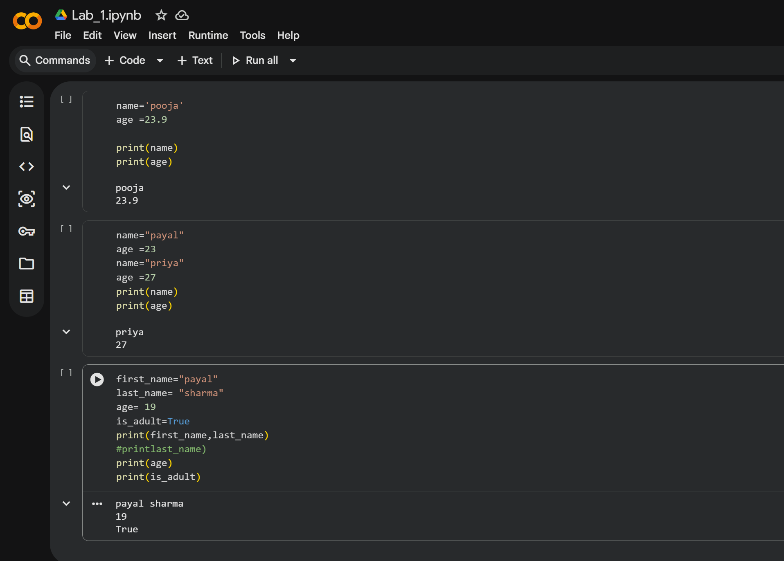

Slide 9
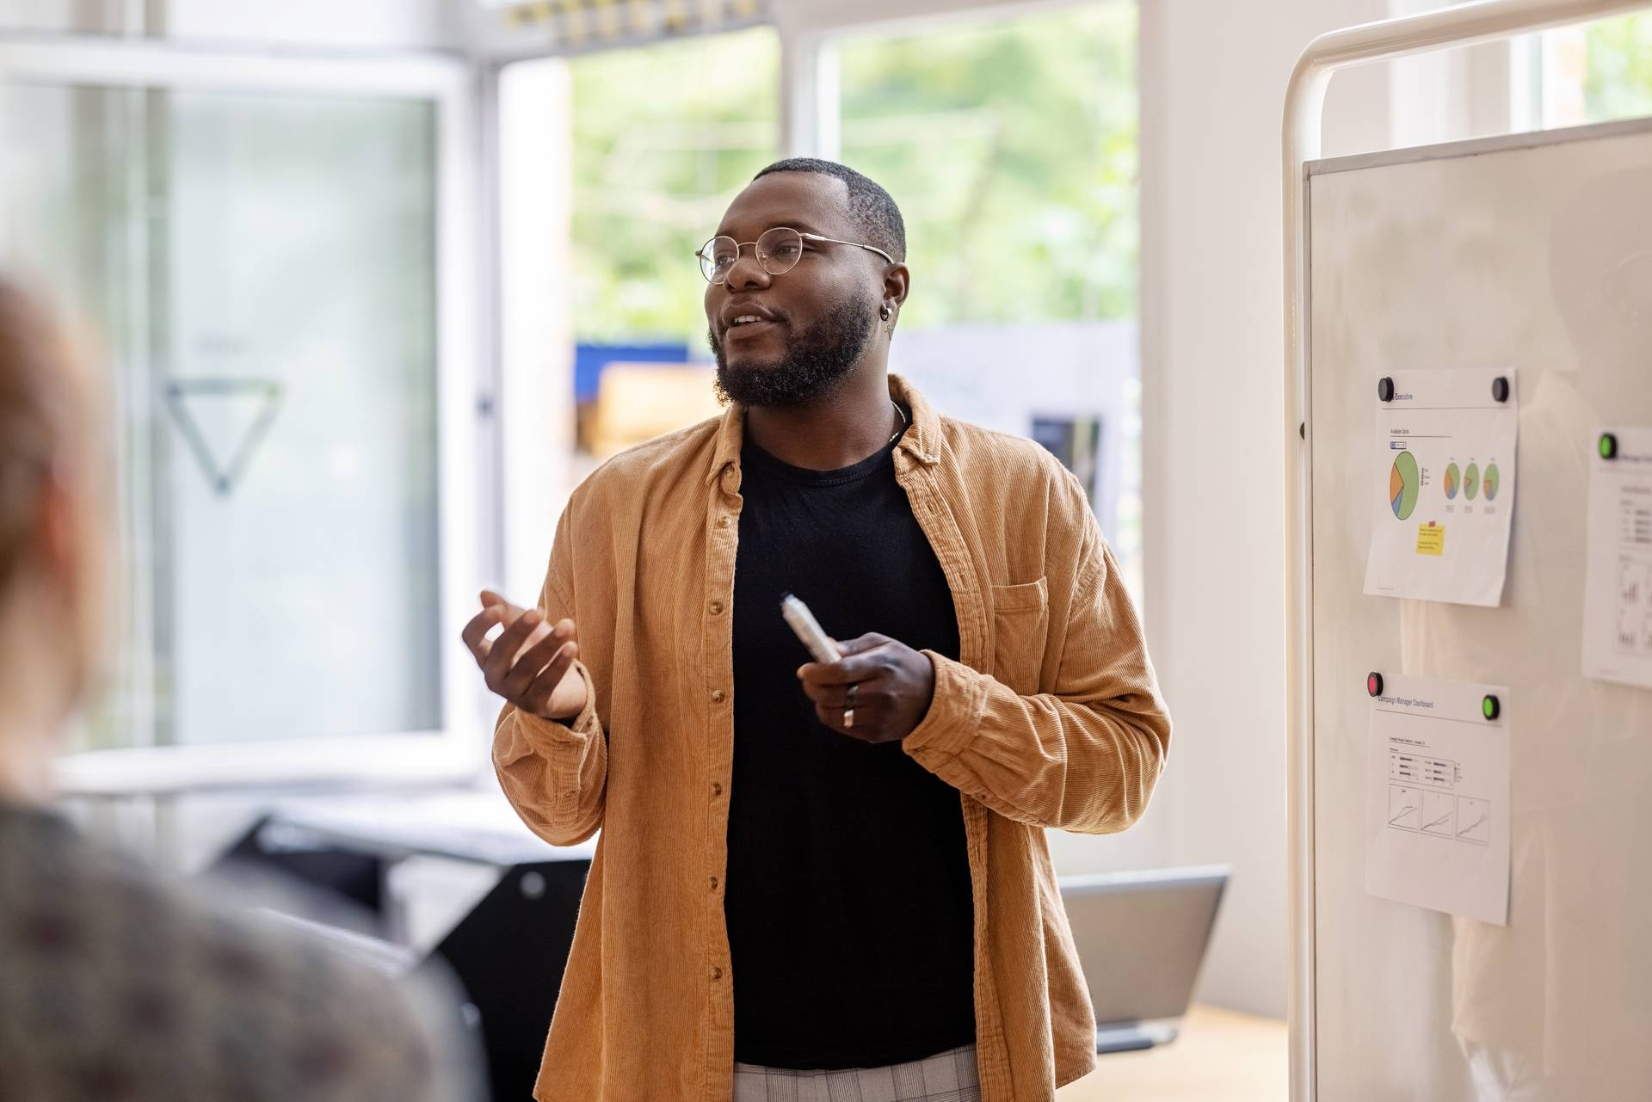
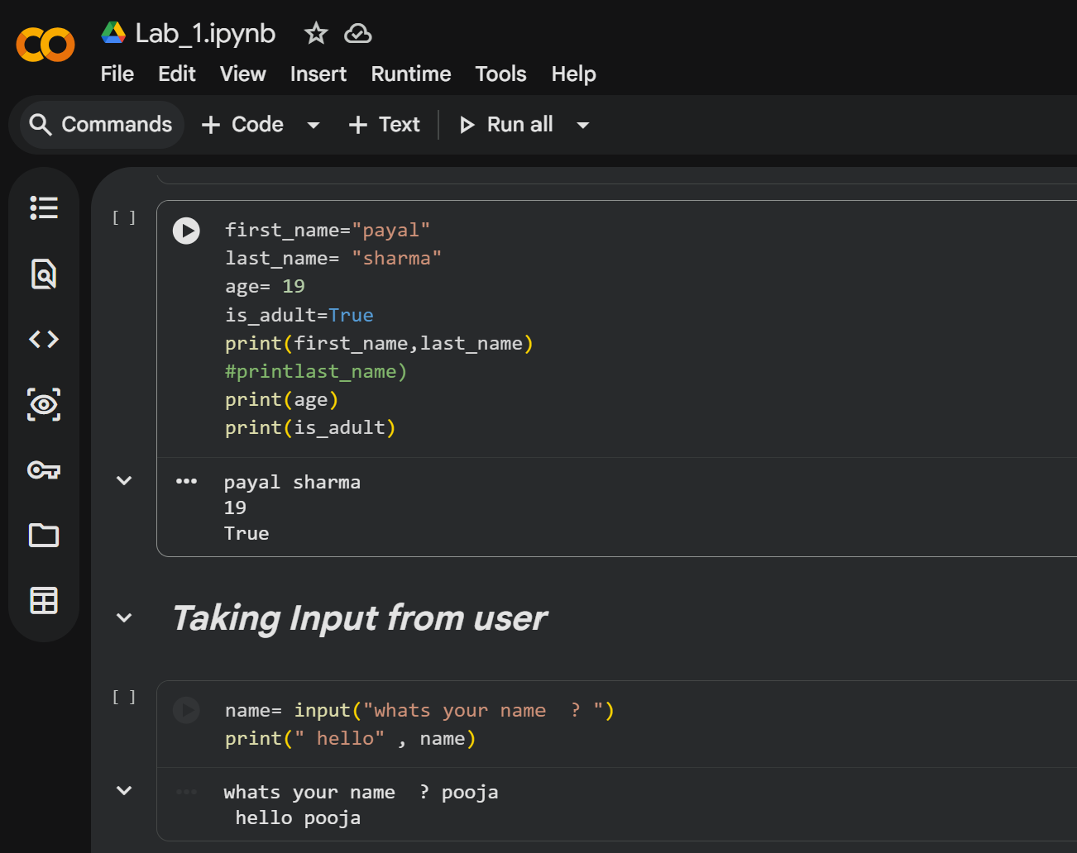

Slide 10
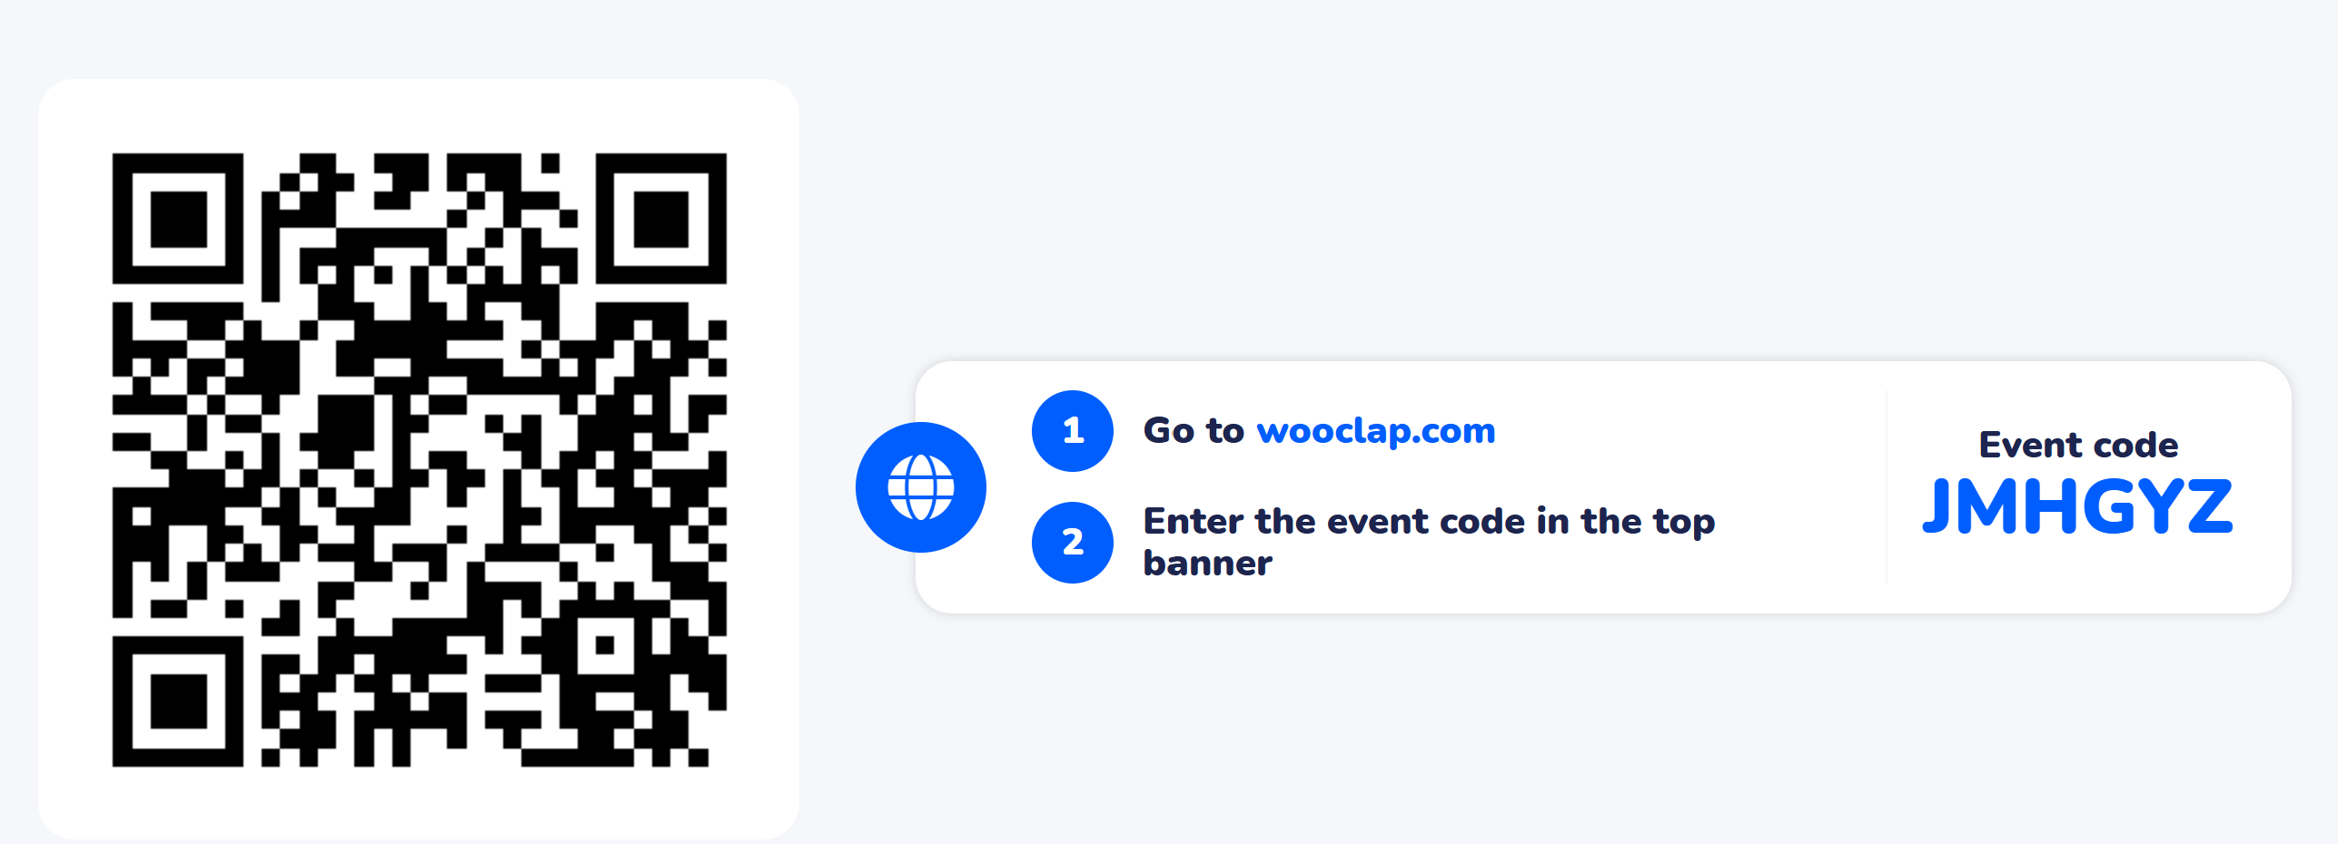
Learning Activity 1

Slide 11
Learning Activity 2
--Open google colab and start coding

Slide 12
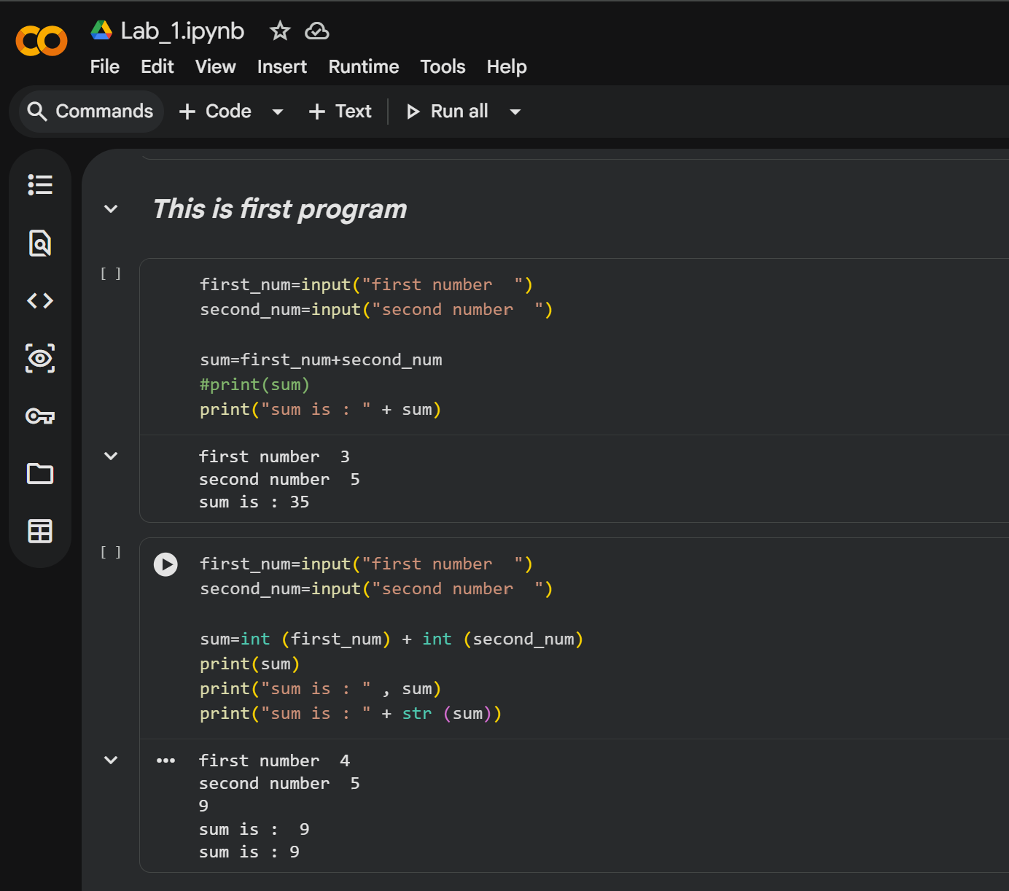

Slide 13
Conclusions-
✅ Python is beginner-friendly and widely used.
✅Understanding syntax, keywords, and data types is essential.
✅ Operators help in performing various computations.
✅ Start coding and explore Python further!

Slide 14
Now Students are able to :
Learning Outcome 1 : what keywords are in Python and why they cannot be used as variable names.
Learning Outcome 2: Understand how to use variables and name them correctly in Python.

Slide 15
post session activities
1. Write a program in python to check whether the given num is positive, negative or zero.
2. Write a program in python to check a givennumber is even or odd.

Slide 16
Next session:
Data Types, Operators, Boolean Values.

Slide 17

Thank You

